Slide 1
Car Care & Basic Maintenance
For Teens

Slide 2
Avoid Trouble, But Be Prepared
Keep Your Vehicle in Good Condition
Inspect it Before Each Trip
Keep Your Cell Phone Charged
Carry Emergency and First Aid Equipment

Slide 3
Maintain Your Car
Walk Around The Car To Look for Scratches and Dings
Before Each Trip
Perform Scheduled Maintenance
Monthly Inspections

Slide 4
The Basics
Tires
Oil
Lights
Gas
Fluids
Cleanliness
Notes:
Keeping your car well-maintained isn't necessarily rocket science. There are a few key inspections that you can do yourself to make sure your car is operating in good shape. Checking things like fluid levels (e.g., oil and coolant) and tire pressure can ensure the good condition (and mileage) of your car. Additionally, keeping tabs on the condition of basic equipment such as windshield wipers, tires, and headlights can mean a world of difference when it comes to driver safety. These small inspections take a short amount of time and go a long way towards keeping you safe.

Slide 5
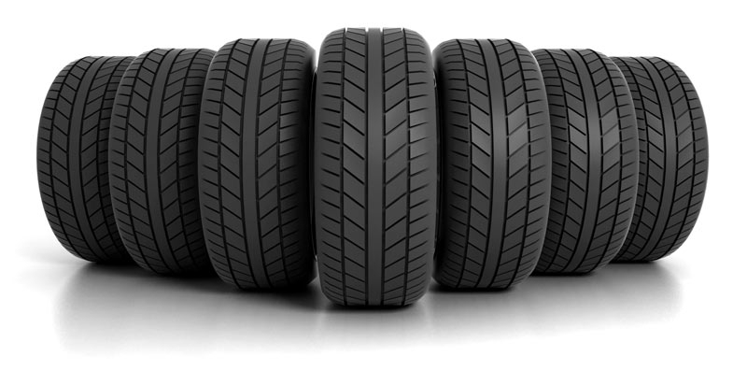
Tires
Notes:
Tires are the only part of your car that have direct contact with the pavement—making them the most important part of your car!

Slide 6
Tires
Check tire pressure and re-inflate once a month. Under-inflation is a leading cause for tire failures. In cold weather, tires can lose up to two pounds of air per month. Maintaining the proper inflation is very simple as long as tires are checked regularly using a pressure gauge.
Notes:
Tires are one of the easiest components of a vehicle to maintain, but they are frequently overlooked until something goes wrong. Every driver should have a tire pressure gauge in their vehicle, know where it is located, and understand how to use it properly. . While there are a variety of tire pressure gauges, those with electronic readouts might be the easiest for a teen to use. Tires should be checked at least once a month when the tires are cold.
You can't tell just by looking at the tires. And if a tire looks low, then it's probably very, very low. If one tire seems to deflate more quickly than others, have it checked as it may have picked up a nail and have a slow leak that could later become a blow-out.

Slide 7
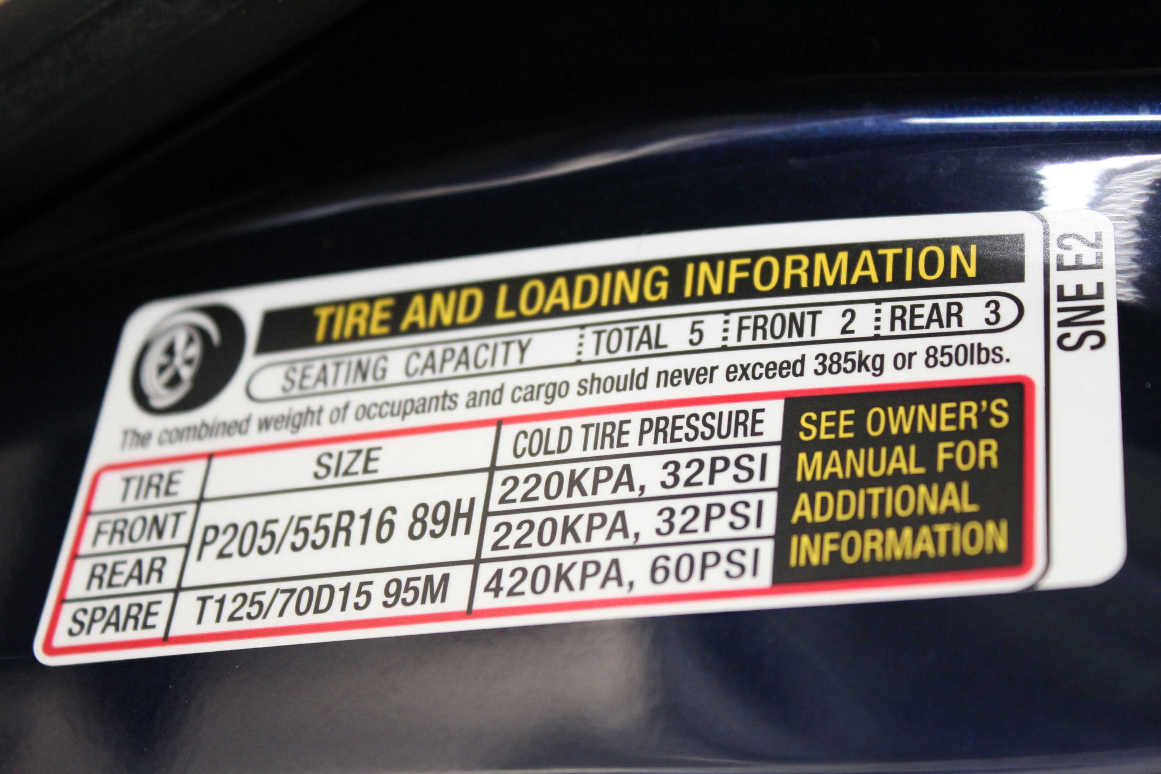
Tire Pressure (PSI)
Notes:
Always follow the inflation pressure recommendations in your vehicle owner’s manual or on the driver’s door jamb.

Slide 8
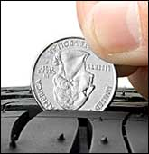
Tread Depth Gauge
Notes:
Check the tread depth of your car’s tires by inserting a quarter upside down into a tire groove. If you can see above Washington’s head at any point, start shopping for new tires.

Slide 9
Gas
Keep the tank filled … and with the right gas. Make sure to check the gas gauge before driving around town and fill-up it up often.
Notes:
It seems like common sense, but it's easy to forget to check and then find yourself stuck on the road side with an empty tank. And empty tank also collects condensation, which can lead to all sorts of other issues in your fuel system over time. It's also important to know what octane gas to put in the car. Most cars do well with regular gasoline, but make sure you know if higher octane or diesel gas is needed.

Slide 10
Oil
The type of engine oil, the age and make of your vehicle and driving habits dictate when to change engine oil.
Always refer to the owner’s manual.
Notes:
Oil keeps all the parts of the engine running smoothly, by reducing friction and keeping metal parts from grating each other.
Oil also takes dirt and other waste particles away from the engine. When the oil is saturated with engine by-products, it no longer functions well and needs to be changed. Older cars may require more frequent oil changes, so should be checked more often.

Slide 11
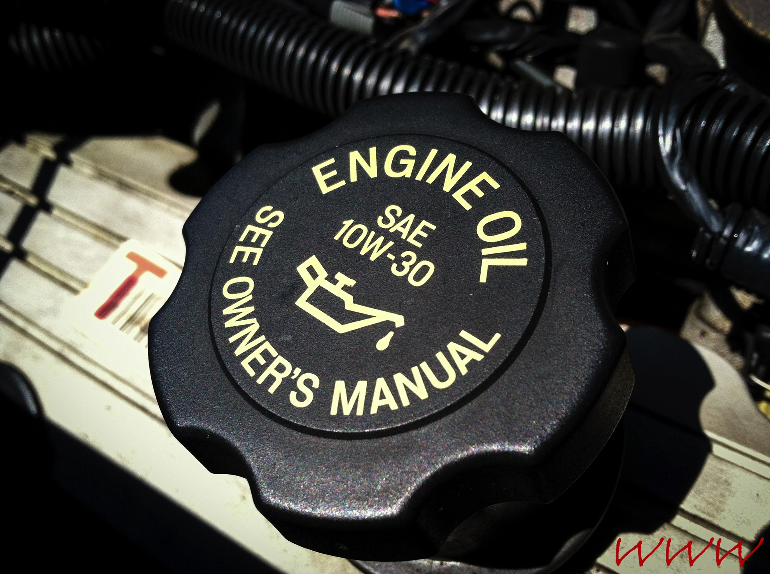
Oil Cap
Notes:
Never touch the oil or radiator cap when hot!

Slide 12
  Coolant
  An overheated engine can suddenly stop at an inconvenient time and place. It's frustrating when this happens, especially since it's a scenario that can easily be avoided.
Notes:
Make sure to prop up the hood open and check whether or not your coolant levels are within your car’s recommended range. It's a very easy and quick task that will save you a load of trouble.

Slide 13
              Lights
Drivers use the car lights to communicate with fellow drivers, so driving with faulty or broken lights can lead to a serious crash.
Notes:
Check your lights at nighttime weekly to make sure they are working effectively.
Headlights-taillights-turn signals-interior/exterior lights

Slide 14
Instrument Panel
The instrument panel helpfully displays warning lights when something is working improperly or running low. These lights will inform drivers when the oil needs to be changed, the engine needs to be checked, etc. You can refer to the owner's manual for the correct response for every warning light.

Slide 15
Car Cleanliness
A regular car wash will make a vehicle cleaner and safer. A dirty windshield can get in the way of driving especially in conditions with less-than-ideal visibility e.g. rain or fog weather conditions. Even a driver with perfect vision will have a harder time navigating with a dirty windshield.

Slide 16
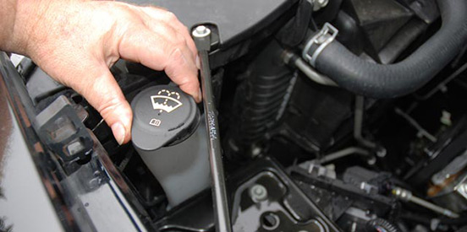
Wiper Fluid

Slide 17
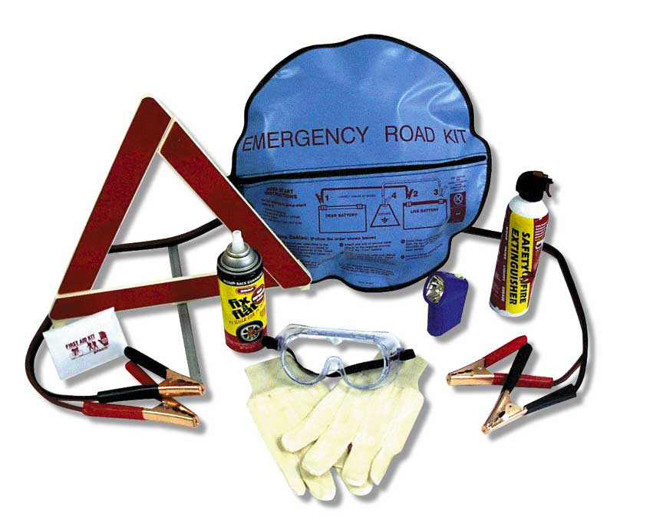
Emergency Equipment
Notes:
A properly inflated spare tire and jack
Flares or reflective devices to alert other drivers of a breakdown
A flashlight
A tool kit (can be travel size)
Jumper cables
A first-aid kit
An empty fuel container (Never carry extra fuel in your vehicle. It is extremely hazardous)

Slide 18
If Your Car Breaks Down While Driving
Don’t Panic
Use Brakes Gradually … if Needed
Get to the Shoulder!!
Signal & Coast to Shoulder (right shoulder preferred)
Beware of Roadside Hazards (trees, ditches)
Stop as Far Off the Roadway as Safely Possible

Slide 19
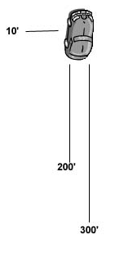
Safely on the Shoulder
Emergency Flashers On
Communicate Your Situation
Raise Hood
Warning Triangles (3)
Location (mile markers or exits)
Assess the Vehicle’s Problem
Call For Help
Wait in the Car (if safe to do so on shoulder)

Slide 20
  1-800-AAA-HELP

