Slide 1
Staying Safe in the Car!
Can you be a Car Seat Safety Champion?

Slide 2
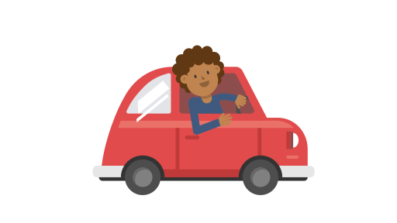
Which picture shows safe car behavior?

Slide 3
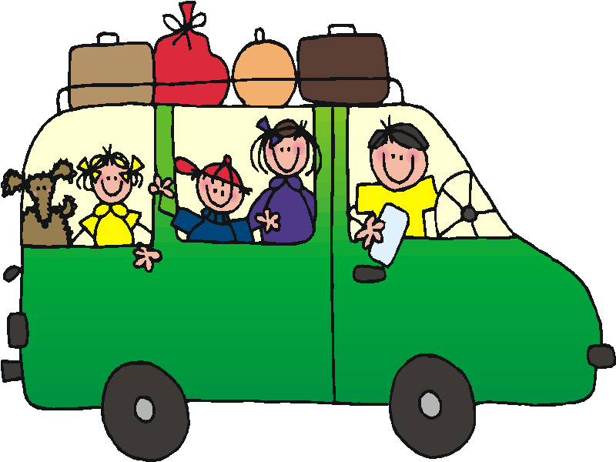
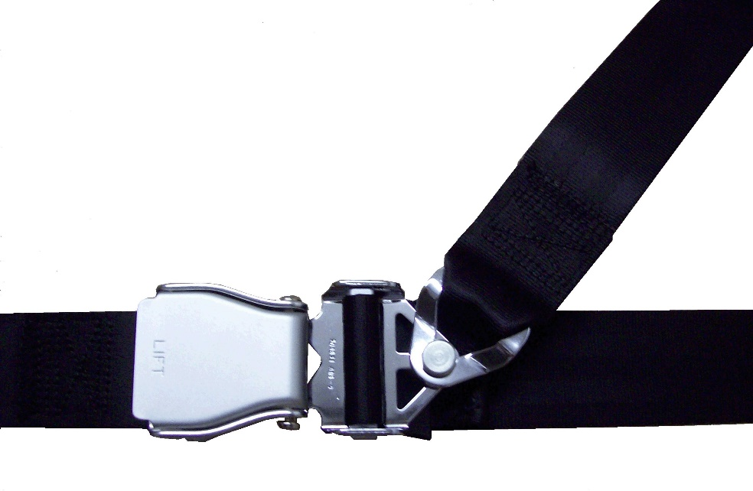
What can keep you safe in the car?

Slide 4
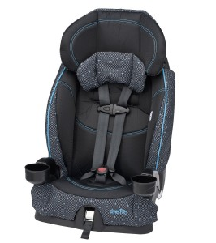
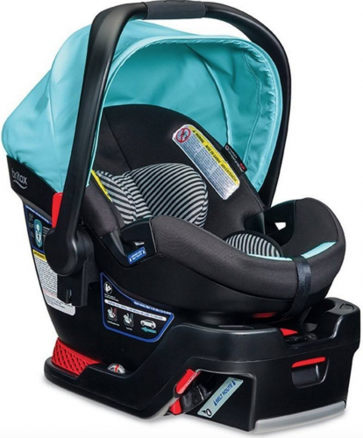
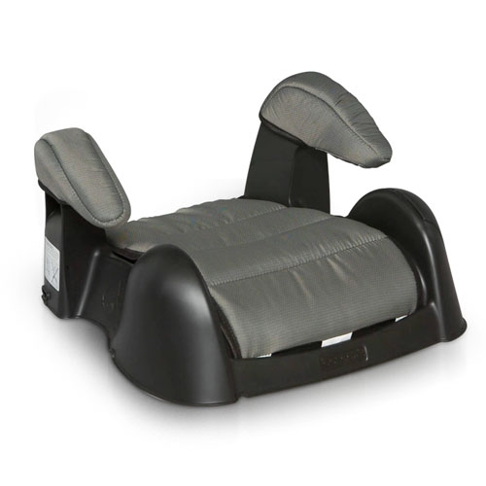
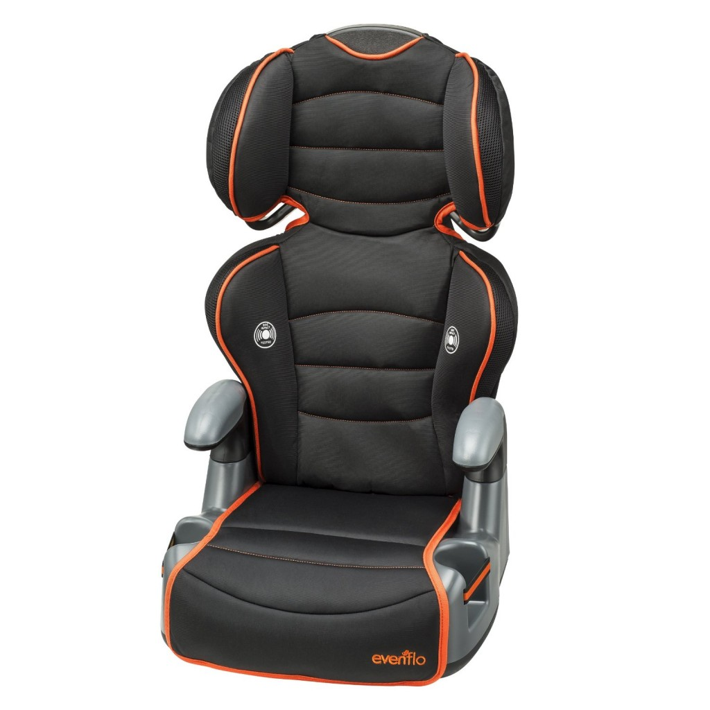
Which seat is right for you?
Booster Seat

Slide 5
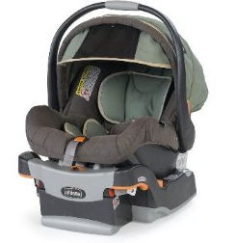
Buckle Up, Big or Small!

Slide 6
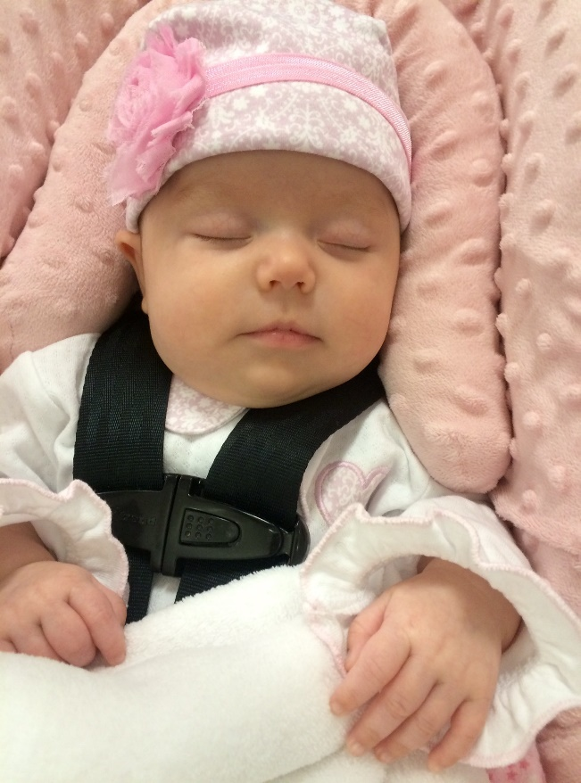
Which do you think are the best behaviors during a car ride?

Slide 7
You now earned the Award!
This Photo by Unknown Author is licensed under CC BY-NC

