Slide 1
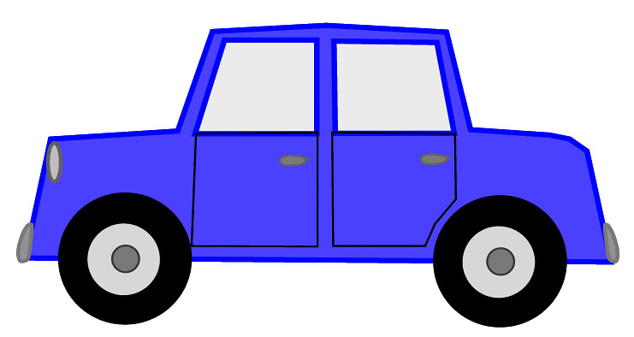

Welcome to
Word scramble
A Car safety game

Slide 2

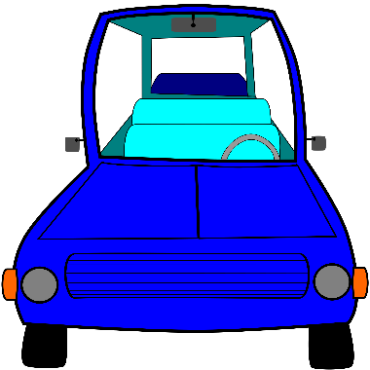
ARE YOU READY TO PLAy?
Car Safety gAME

Slide 3

TAKE A LOOK AT
THE NEXT
TWO SLIDES FOR CLUES AND THEN
MOVE ON TO UNSCRAMBLE THE
MATCHING WORd!

Slide 4




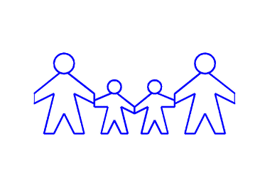

Slide 5

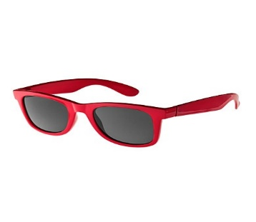
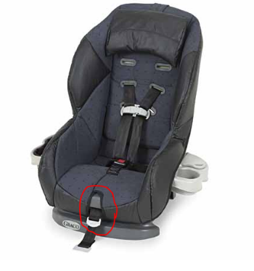

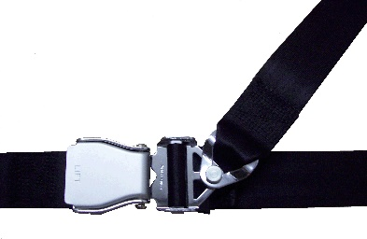

Slide 6
1) RAC SATE ___________
2) EKLUCB PU ___________
3) MAFLIY ___________
4) TSLINE ___________
5) AERD ___________
6) EB FESA ___________
7) EQUIT MITE ___________
8) YFTESA TLEB___________
9) ROHN ___________
10) GLUNSSSAES __________
Don’t forget
to check out
the clues!

Slide 7


What was your score?
_____ out of 10
What other words
can you think of?

Slide 8
Answer Key:
CAR SEAT
BUCKLE UP
FAMILY
LISTEN
READ
BE SAFE
QUIET TIME
SAFETY BELT
HORN
SUNGLASSES

Slide 9



