Slide 1
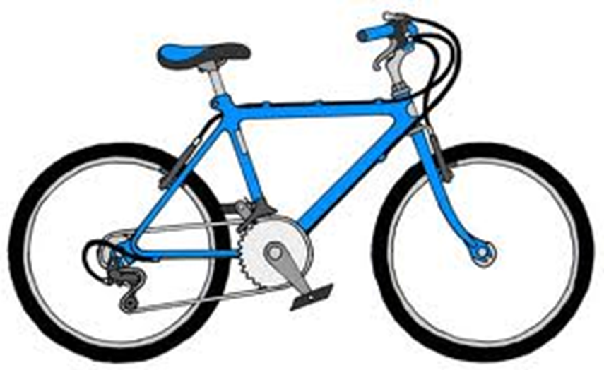
Staying Safe on Your Bicycle

Slide 2
What’s wrong with this picture?
Each of the following pictures will have a bicycle safety problem.
Use the mouse to click on the correct answer to the question.
“What’s wrong with this picture?”

Slide 3
The helmet is too small.
The helmet is not protecting the front of the man’s head.
The man’s chin strap is too tight.

Slide 4
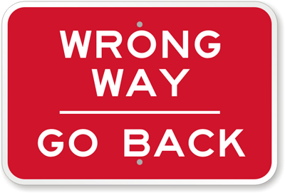
Not quite!
The helmet is not to small.
Try again

Slide 5
Not quite!
His chin strap looks like it fits!
Try Again

Slide 6
Correct!
The helmet does not pass the eyebrow test, so it is not protecting the front of his head.
Continue

Slide 7
Her helmet is pink.
Her helmet is on backwards.
Her chin strap is not tight enough.

Slide 8
Not quite!
Bicycle helmets can be any color!
Try Again

Slide 9
Not quite!
Her helmet is not backwards.
Try Again

Slide 10
Correct!
Her chin strap is way too lose!
Continue

Slide 11
The bicycle tire is not inflated.
The bicycle is too big for the boy to ride.
The bicycle tire is over inflated.

Slide 12
Correct!
The tire is flat and won’t work well.
Continue

Slide 13
Not quite!
The boy could ride the bicycle.
Try Again

Slide 14
Not quite!
The tire needs to be filled with more air.
Try Again

Slide 15
The bicycle’s handlebars are crooked.
The bicycle’s tires are flat.
The student is riding the wrong way.

Slide 16
Not quite!
The handlebars are not crooked.
Try Again

Slide 17
Not quite!
The tires look properly inflated.
Try Again

Slide 18
Correct!
The student is riding the wrong way in the street.
Continue

Slide 19
The biker is not wearing a helmet.
The biker is riding too close to the car.
The biker is riding on the wrong side of the road.

Slide 20
Not quite!
The biker is wearing a helmet.
Try Again

Slide 21
Correct!
The biker is riding too close to the car. If the driver, opens his door without looking the biker could get hurt.
Continue

Slide 22
Not quite!
The biker is riding on the correct side of the road.
Try Again

Slide 23
The bicycle’s tires are too small.
The biker is wearing the wrong colors.
The biker is riding too close to the curb.

Slide 24
Not quite!
The tires are the right size.
Try Again

Slide 25
Not quite!
The bicyclist is wearing appropriate colors.
Try Again

Slide 26
Correct!
The biker is riding too close to the curb and could get hurt.
Continue

Slide 27
The biker is wearing dark clothing.
The bicycle has a light on it.
The biker has gloves on.

Slide 28
Correct!
The bicyclist is wearing dark clothing which would make him difficult to see.
Continue

Slide 29
Not quite!
It is great that the man has a light on his bicycle to brighten his way.
Try again

Slide 30
Not quite!
The bicyclist can wear gloves to aid in griping the handlebars.
Try again

Slide 31
The biker is riding on the wrong side of the road.
The biker is riding too close to the cracks in the road.
The biker has lights on their bicycle.

Slide 32
Not quite!
We can’t tell which side of the road the biker is riding on.
Try again

Slide 33
Correct!
Riding to close to the cracks could be dangerous.
Continue

Slide 34
Not quite!
The biker can wear gloves to aid in griping the handlebars.
Try again

Slide 35
The biker is not seated correctly.
The biker is not riding in the bike lane.
The biker does not have knee pads on.

Slide 36
Not quite!
The biker is seated correctly.
Try again

Slide 37
Correct!
The bicycle lane is the special lane for bikes to ride in.
Continue

Slide 38
Not quite!
Knee pads are great, but the biker is not required to wear them.
Try again

Slide 39
The rider is not wearing appropriate shoes.
The bicycle chain is tangled.
The bicycle is too big for the rider.

Slide 40
Correct!
Flip flops are not safe footwear for biking. Continue

Slide 41
Not quite!
The bicycle’s chain looks fine.
Try again

Slide 42
Not quite!
The bicycle is an appropriate size for the rider.
Try again

Slide 43
The biker is wearing an unsafe helmet.
The biker has a basket attached to the handlebars.
The biker is wearing a skirt.

Slide 44
Not quite!
The biker is wearing an appropriate helmet.
Try again

Slide 45
Not quite!
The biker can have a basket attached to the handlebars.
Try again

Slide 46
Correct!
A skirt could impede the biker’s range of motion and get tangle in the bicycle. Continue

Slide 47
The bicycle is the wrong color.
The handlebars are too low.
The biker’s shoes are not safe for biking.

Slide 48
Not quite!
The bicycle can be any color!
Try again

Slide 49
Not quite!
The handlebars are at the correct height.
Try again

Slide 50
Correct!
High heels are not safe to wear when riding a bicycle. Continue

Slide 51
The boy’s shoe is untied.
The bicycle is too big for the boy.
The bicycle tires are flat.

Slide 52
Correct!
The boy’s shoe is untied and it could get caught on a part of the bike. Continue

Slide 53
Not quite!
The bicycle is a correct size for the boy.
Try again

Slide 54
Not quite!
The bicycle tires look properly inflated.
Try again

Slide 55
The man is wearing a helmet.
The man is too big for the bicycle.
The bicycle has training wheels.

Slide 56
Not quite!
The man is not wearing a helmet.
Try again

Slide 57
Correct!
The bicycle is much too small for the man. Continue

Slide 58
Not quite!
A bike can have training wheels.
Try again

Slide 59
The biker is talking on his cell phone.
The bike is red.
The bicycle’s wheels are too big.

Slide 60
Correct!
It is dangerous and distracting for a biker to be on their cell phone while riding. Continue

Slide 61
Not quite!
A bike can be any color!
Try again

Slide 62
Not quite!
The bicycle’s wheels are a correct size.
Try again

Slide 63
The biker is riding on the wrong side of the road.
The biker has the wrong type of shoes.
The biker is wearing headphones.

Slide 64
Not quite!
We can’t tell if the biker is riding on the correct side of the road.
Try again

Slide 65
Not quite!
The bicycle is wearing appropriate shoes.
Try again

Slide 66
Correct!
It is dangerous and distracting for a biker to have headphones on while riding, because they won’t be able to hear as well. Continue

Slide 67
Great job figuring our what was wrong with the pictures!

Slide 68
What do you think a safe cyclist looks like?

Slide 69
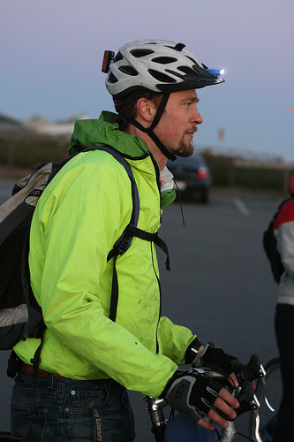
A safe cyclist is… Visible

Slide 70
Uses hand signals

Slide 71
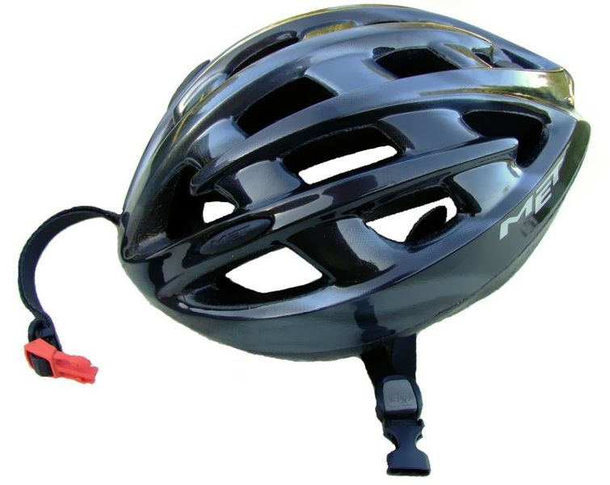
Wears appropriate gear

Slide 72
Puts their helmet on correctly

Slide 73
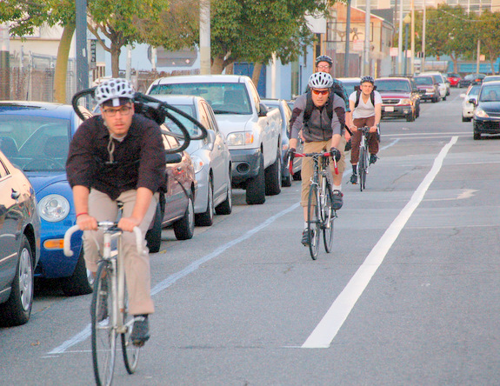
Rides on the Right side of the road or the Bicycle lane

Slide 74
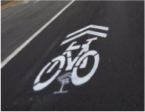
This is a shared lane. This lane is shared between cars and bicycles. Both car drivers and bikers should travel using caution.
This is a bicycle lane. Specifically, made only for bicycles to ride. Cars are not legally allowed to drive over or in this lane.

Slide 75
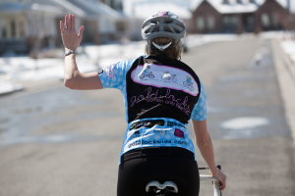
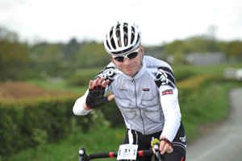
Communicates with others

Slide 76
Gives vehicles plenty of space

Slide 77
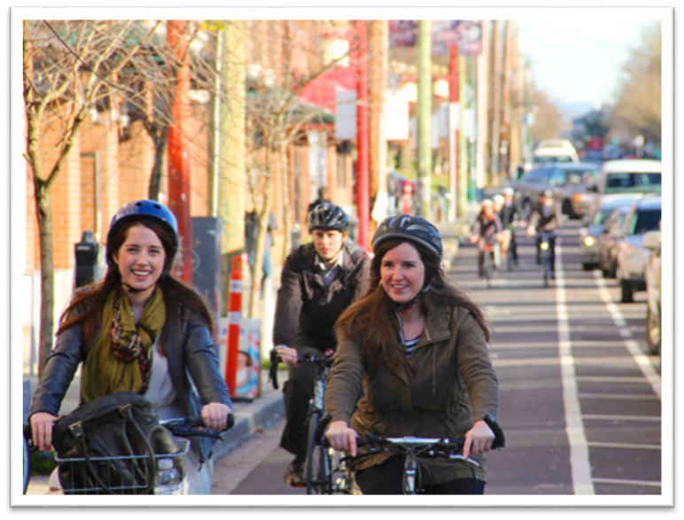
Great job!
Ride Safely!

